Slide 1
Partner practice
WhiteBoarD
REVIEW
Unit 6
Chapter 8 Review

Slide 2
DRAW
-The basic shape of the graph of a linear equation
-The basic shape of the graph of an exponential equation
Unit 6 Review

Slide 3
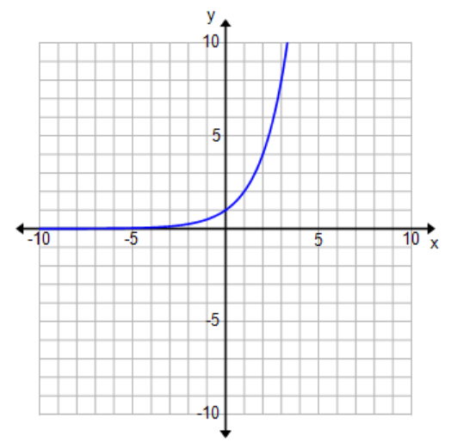
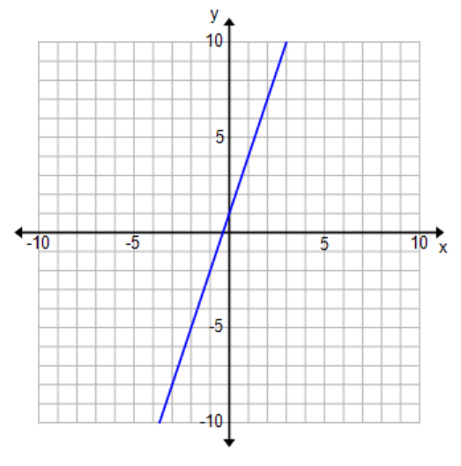
Draw
Unit 6 Review

Slide 4
Use the following Table to WRITE the equation of the function
x | -2 | -1 | 0 | 1 | 2 | 3
y | 1/7 | 1 | 7 | 49 | 343 | 2401
Unit 6 Review

Slide 5
Use the following Table to WRITE the equation of the function
x | -2 | -1 | 0 | 1 | 2 | 3
y | 1/7 | 1 | 7 | 49 | 343 | 2401
Unit 6 Review

Slide 6
Use the following Table to WRITE the equation of the function
x | -2 | -1 | 0 | 1 | 2
y | 512 | 384 | 288 | 216 | 162
Unit 6 Review

Slide 7
Use the following Table to WRITE the equation of the function
x | -2 | -1 | 0 | 1 | 2
y | 512 | 384 | 288 | 216 | 162
Unit 6 Review

Slide 8

Simplify
Unit 6 Review

Slide 9
Simplify
Unit 6 Review

Slide 10
Simplify
Unit 6 Review

Slide 11
Simplify
Unit 6 Review

Slide 12
Simplify
Unit 6 Review

Slide 13
Simplify
Unit 6 Review

Slide 14
Simplify
Unit 6 Review

Slide 15
Simplify
Unit 6 Review

Slide 16
Simplify
Unit 6 Review

Slide 17
Simplify
Unit 6 Review

Slide 18
Simplify
Unit 6 Review

Slide 19
Simplify
Unit 6 Review

Slide 20
Simplify
Unit 6 Review

Slide 21
Simplify
Unit 6 Review

Slide 22
Simplify
Unit 6 Review

Slide 23
Simplify
Unit 6 Review

Slide 24
Exponential Growth or Decay?
Unit 6 Review

Slide 25
Exponential Growth or Decay?
Unit 6 Review

Slide 26
Exponential Growth or Decay?
Unit 6 Review

Slide 27
Exponential Growth or Decay?
Unit 6 Review

Slide 28
Exponential Growth or Decay?
Unit 6 Review

Slide 29
Exponential Growth or Decay?
Unit 6 Review

Slide 30
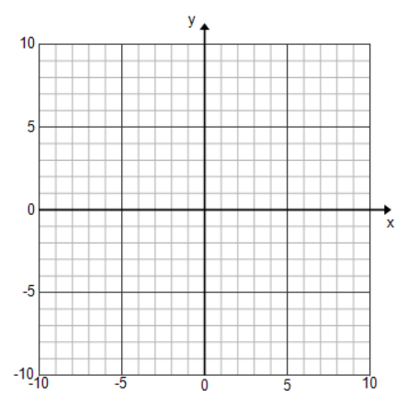
Graph the function

Slide 31
Graph the function

Slide 32
Answer the following exponential growth/decay problem
You deposit $5,000 in an account that pays 5.25% interest compounded yearly. What will the account balance be in 20 years?
Unit 6 Review

Slide 33
Answer the following exponential growth/decay problem
You deposit $5,000 in an account that pays 5.25% interest compounded yearly. What will the account balance be in 20 years?
Unit 6 Review

Slide 34
Answer the following exponential growth/decay problem
The population at LTHS has been decreasing by 10% each year. In 2003, there were about 1800 students at LT. What will be the population in the year 2013?
Unit 6 Review

Slide 35
Answer the following exponential growth/decay problem
The population at LTHS has been decreasing by 10% each year. In 2003, there were about 1800 students at LT. What will be the population in the year 2013?
Unit 6 Review

Slide 36
If the amount of money you have in a saving account can be modeled by the equation y = 3250(1.03)^{t} . How much money did you put in the account to begin and what percent is the account growing by?
Unit 6 Review

Slide 37
If the amount of money you have in a saving account can be modeled by the equation y = 3250(1.03)^{t} . How much money did you put in the account to begin and what percent is the account growing by?
Unit 6 Review

Slide 38
Using the equation from the last problem:
y = 3250(1.03)^{t} . Determine how long it would take for your account to grow over 5000 dollars.
Unit 6 Review

Slide 39
Using the equation from the last problem:
y = 3250(1.03)^{t} . Determine how long it would take for your account to grow over 5000 dollars.
Unit 6 Review

